Slide 1
Marketing guide

Slide 2
TIMELINE-
NIGHT BEFORE OPENING “GO LIVE”
PRE-CONSTRUCTION (12 WEEKS OUT)
PLACE ALL MARKETING MATERIALS PER THE PLAN-O-GRAM RECEIVED. THIS INCLUDES ALL ELEMENTS OF THE PRINT MEDIA PACKAGE.
SIT DOWN WITH THE WALMART MANAGER
ORDER PRE-OPENING KIT
REACH OUT TO LOCAL “CLIPPER” MAGAZINE FOR OPENING/AD
OPENING DAY
6 WEEKS/5 WEEKS PRIOR TO OPENING
SAMPLE
GIVE AWAYS
WALMART RADIO ANNOUNCEMENTS
ORDER THE PRINT MEDIA PACKAGE & INSPECT WITHIN 48 HOURS OF DELIVERY
FINALIZE A MAILER AND SET IT UP FOR EXECUTION IF YOU ARE DOING IT (CLIPPER MAGAZINE?)
90/120 DAY REFRESH & ONGOING MARKETING
ASSOCIATE APPRECIATION
(PRE-OPEN- 1 DAY BEFORE “GO LIVE”)

Slide 3
PRE-CONSTRUCTION (12 WEEKS OUT) Building Partnerships through Walmart relationships- best practices
Sit down with the Walmart General Manager
Introduce yourself and keep them informed of all critical deadlines etc. with your restaurant. Show them how excited you are to become part of the Walmart Family
Topics may include but are not limited to-
Meet and greet/introductions.
Any promotional materials that will be installed during the pre- grand opening and for the weeks surrounding it, show the “Plan O Gram” & all the items you are going to display. Be sure to get approval and buy off from the Walmart Manager
Any discounts or offers that will be introduced to the Walmart staff. Show the discount poster that goes in the breakroom (example- discounts have been 10-20 % off.)
Ask to be part of the Walmart daily team rallies for the 1st week or 2 after opening.
Ask if announcements be made on the loudspeaker for the grand opening directing people to visit the new MIAMI GRILL…?
Discuss important dates like construction completion and “Go Live.”
Can they do a “AD” on the back TV Wall in the Electronics Department?
TOOLS:
Independent Operator Service Handbook will give you the details of what you are officially allowed to put up during the Opening. If the Walmart Manager is saying they will not allow something, be sure to contact CDS so they may step in and provide guidance. This Handbook can be found under ”Resources” located on: www.miamigrill.twintowersmarketing.com

Slide 4
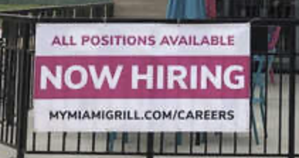
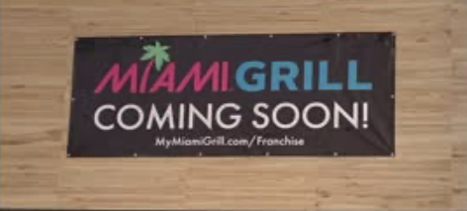
ORDER THE PRE-OPENING KIT
(12 WEEKS OUT)
LOG ONTO: www.miamigrill.twintowersmarketing.com
Order the Pre-Opening Kit which includes, but is not limited to :
Standee
Graphics USB for Walmart Electronics TV
Coming Soon Banner
Now Hiring Sign

Slide 5
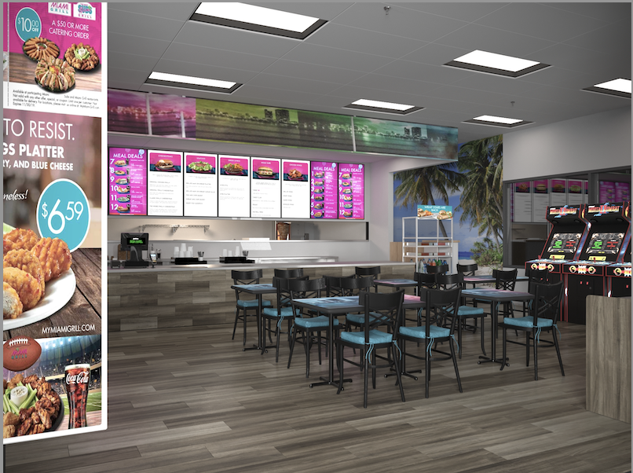
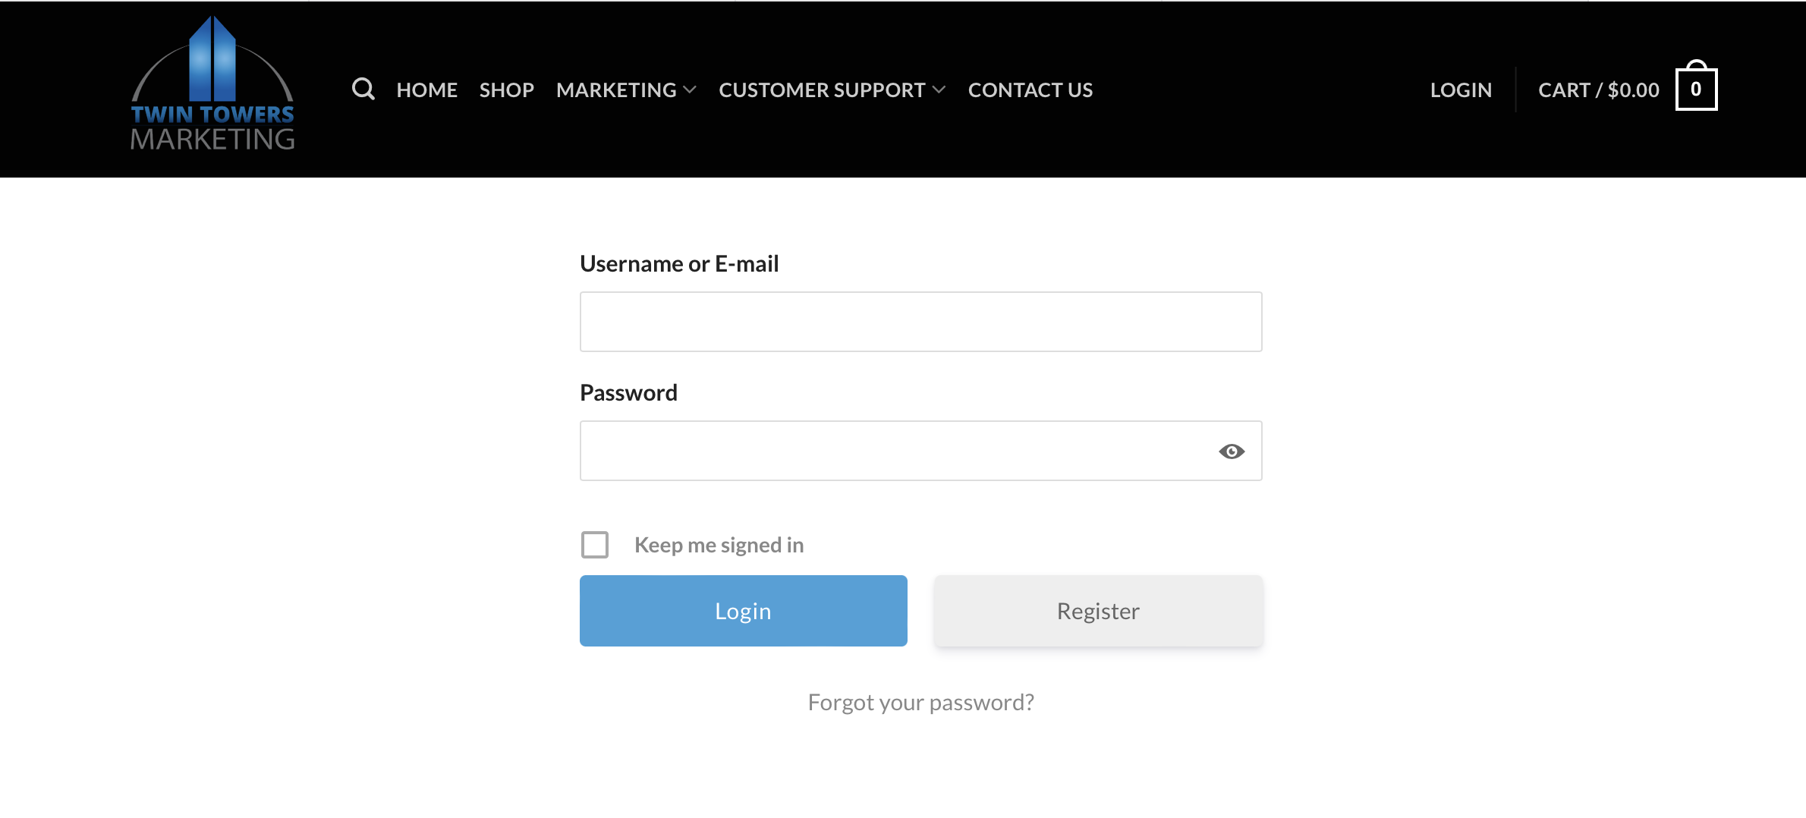
Order the opening package (6 weeks Out)
WELCOME
Miami Grill Operators
We’re your marketing headquarters for MG inside Walmart restaurant locations. Bookmark and join our newsletter for product updates and specials
Once you have sat down with the Walmart Manager to discuss the materials the Tenant logs onto the Twin Towers Marketing Website. If there are any issues with the Walmart Manager reach out to CDS immediately.
Clicks to order to the New Restaurant Print Media Package
Click to order the New Restaurant Print Media Package
Add it to the shopping cart & pay
Package shows up in 1-2 weeks all on 1 pallet
Pallet ”MUST BE” checked in for contents & damages within 24-48 hours. Report any missing or damages on FMX within that timeframe
https://miamigrill.twintowersmarketing.com
Create a Log in

Slide 6
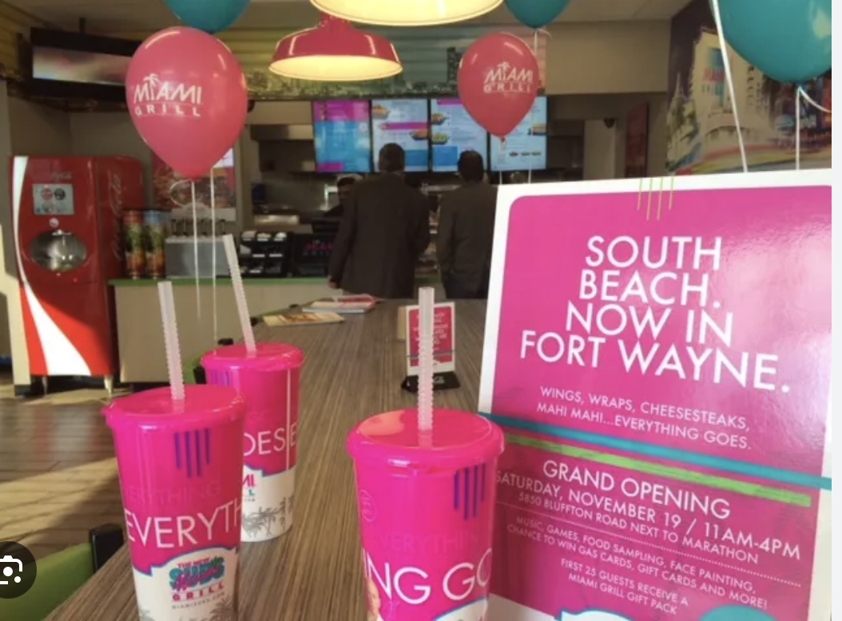
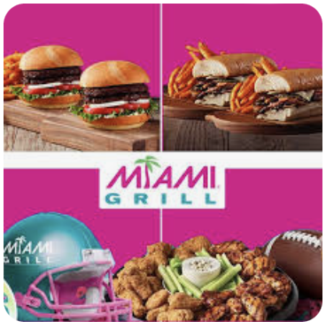
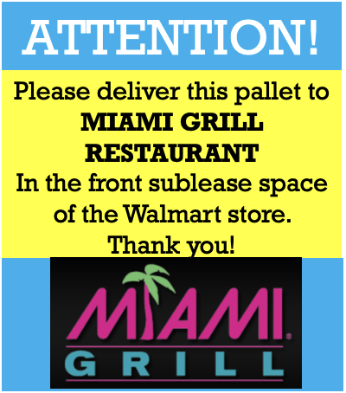
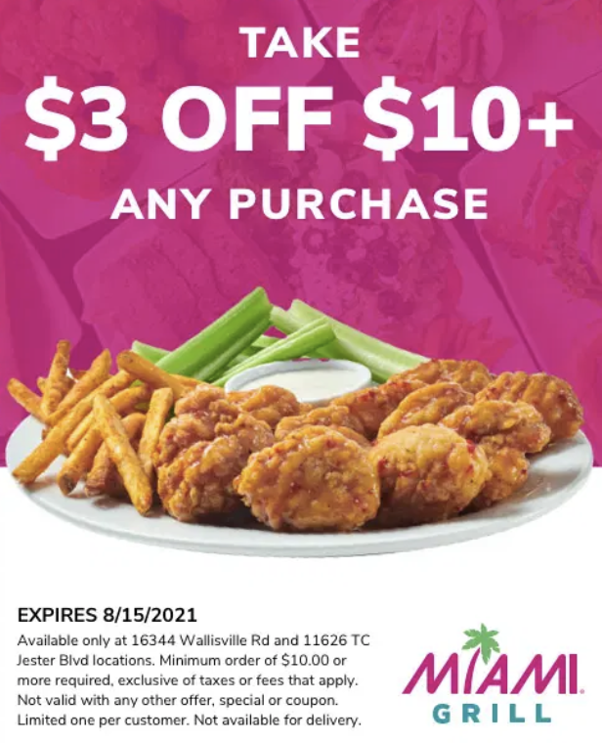
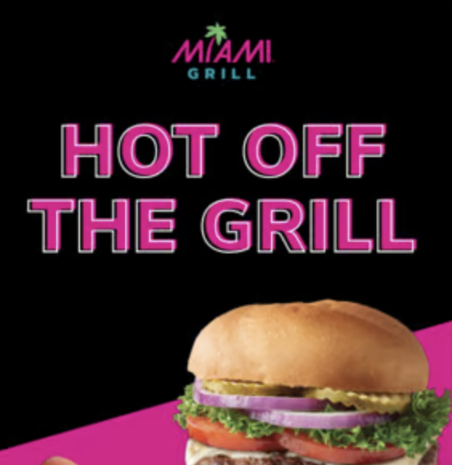
5 Weeks out- check in the Print Media Package upon delivery
HOME /MG OPENING PACKAGES Opening Print Package
Includes all print marketing materials needed for your Miami Grill Restaurant inside a Walmart store. Products are bundled on a single pallet for freight delivery. Shipping to Walmart store is required.
See below for full product list.
**Pallet ships to Walmart receiving dock. Please provide Walmart shipping address during checkout!**
Note: Some Items below may change in the coming months…
DESCRIPTION
Twin Towers Starter Signage Kit Includes These Products:
(2) Vertical Banner Stand Kits* – $378
(1) Horizontal 6×2 Banner – $37
(1) A-Frame Sign Kit with Hardware + (2) 24″ x 36″ Signs – $180
(10) Picket Sign Kits 36″ x 24″ Signs with Ground Stakes – $297
(6) Feather Flag Kits – 10ft. Flags with Ground Poles – $948
(20) Styrene Wall Posters** 9″ x 12″ – $180
(2500) Takeout Menus 5.5″ x 8.5″ – $170
(8) Door Clings 9″ x 6″ – $144
(1) Hours of Operations Metal Sign with Hardware– $100
(1) Number Decal Kit – 5 sheets – $42
(3) Panel Hanging Frame System with Hardware and POP Inserts- $ 198.00
(1) Set of Bag Stuffer Coupons- $ 100.00
*Vertical Banner Stand Kits include (3) 2′ x 6′ banners, (2) double-sided 24″ x 18″ banner toppers,
and (2) hardware kits. **Styrene Wall Posters include (5 each of 4 different designs) Walmart Associate Discounts

Slide 7
Welcome to Miami grill now located inside of your Walmart location

Slide 8
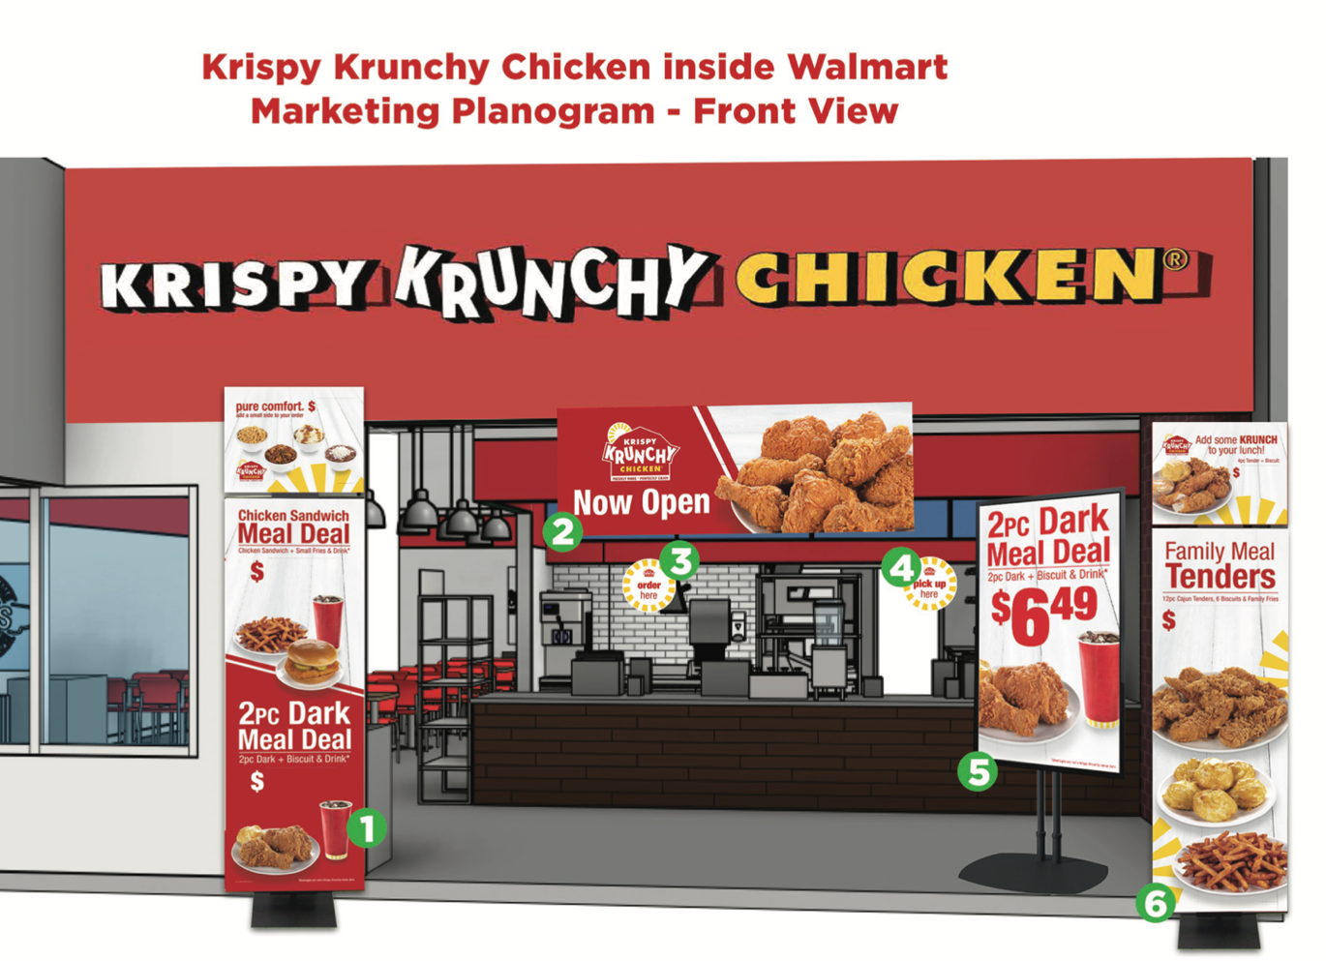
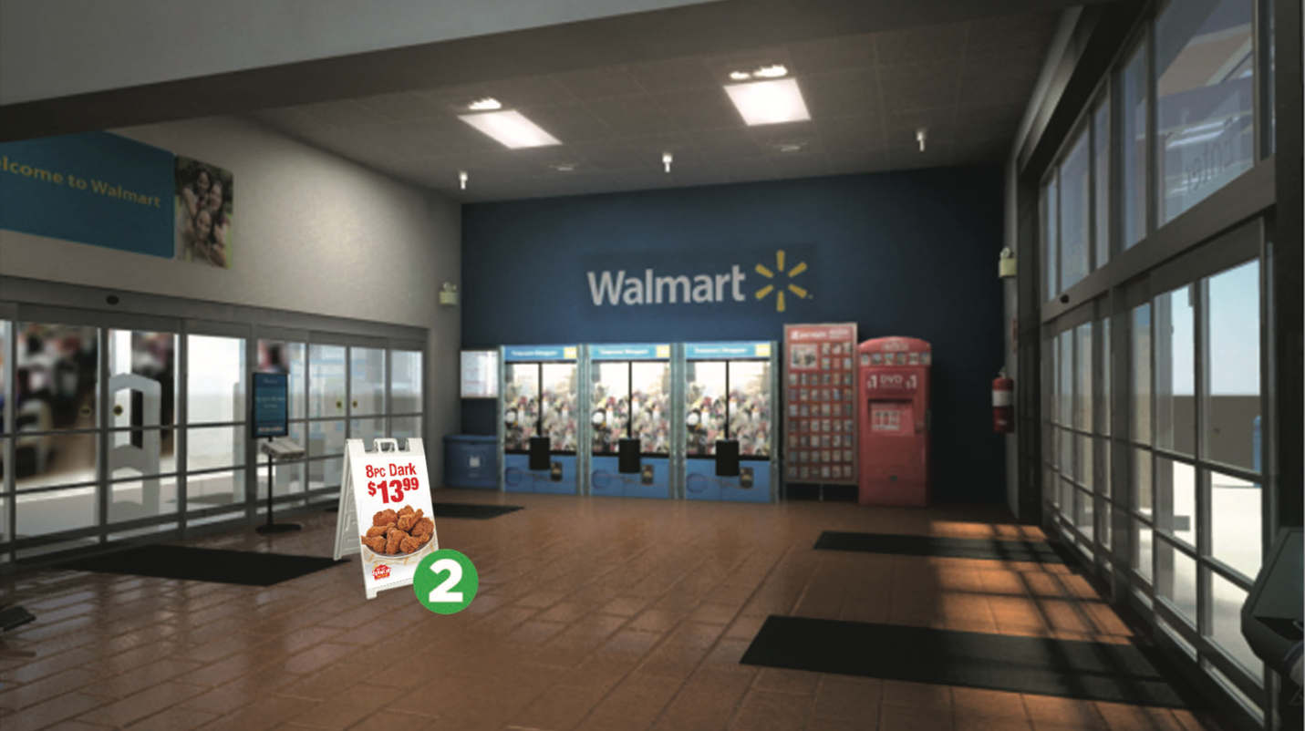
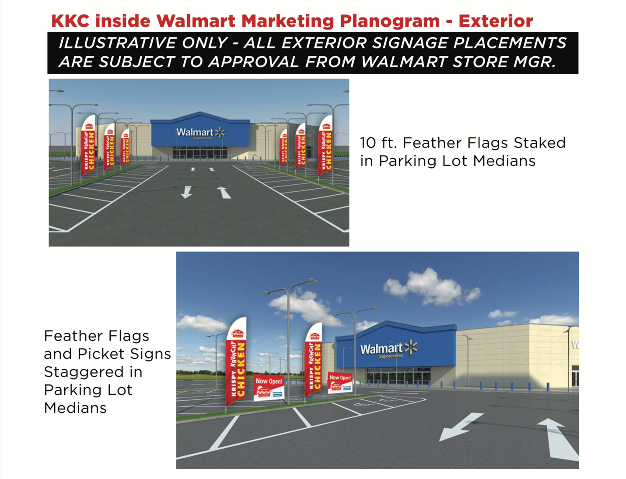
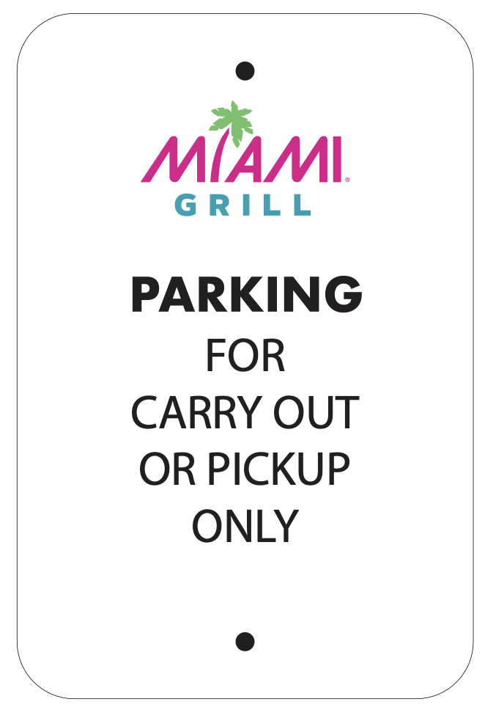
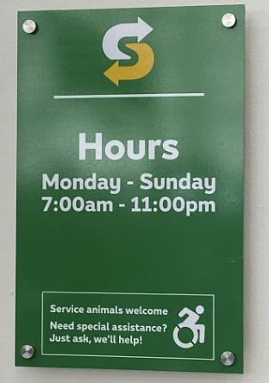
PRE-OPEN- (1 day before “Go Live”)
Each brand has a brand specific “Plan-O-Gram” for the placement of all the Print Media Package items. The one here is an example.
Each brand has a branded hours of operations sign. The one here is an example.
Each brand has branded parking signs.
Hours Sign and Parking Signs …

Slide 9
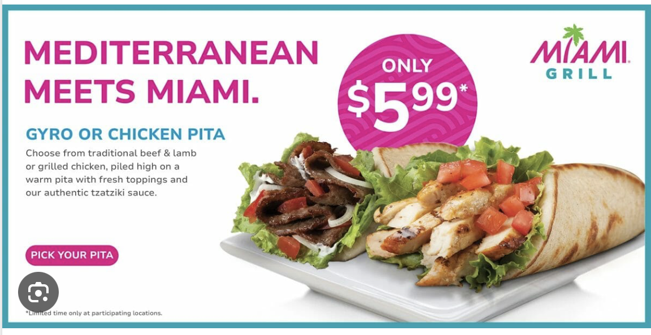
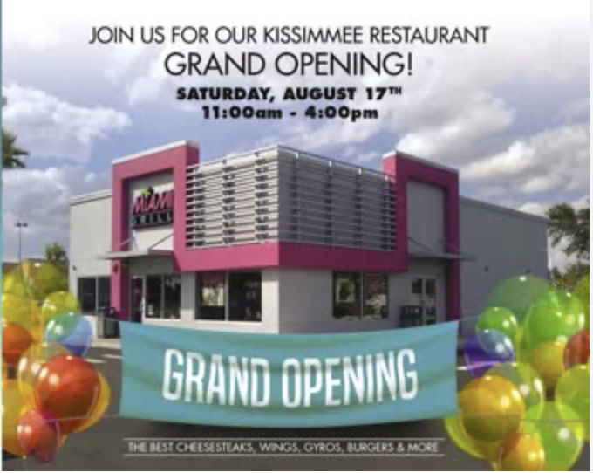
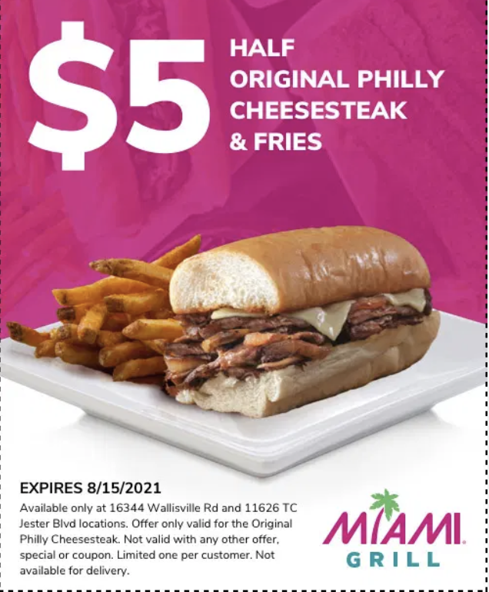
OPENING DAY
HOW TO SAMPLE-
DELIVER THE SAMPLE ON A TOOTHPICK W/NAPKIN OR A SMALL SAMPLE CUP
ICEE
CHICKEN
SNACK OFFERING
HAND THE COUPON OR OFFER: HAVE AN EMPLOYEE STAND AT THE LEASE LINE AND HAND OUT COUPONS & OFFERS

Slide 10
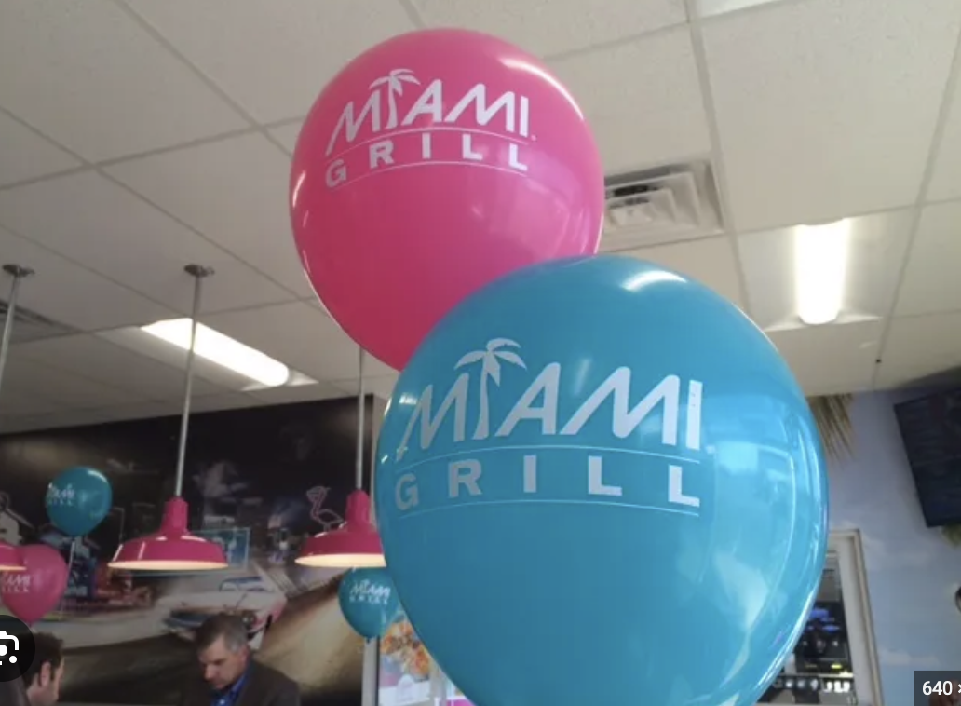
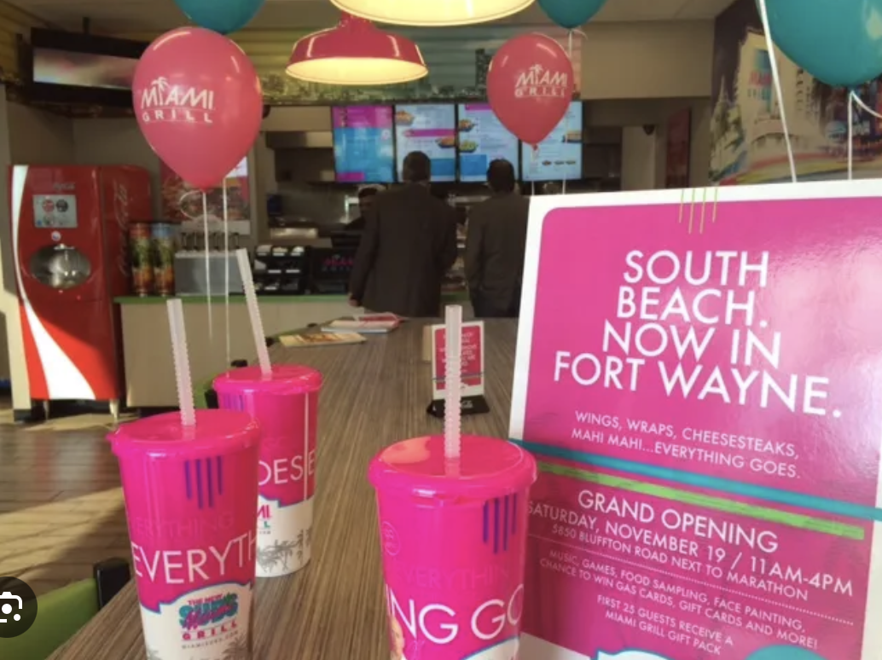
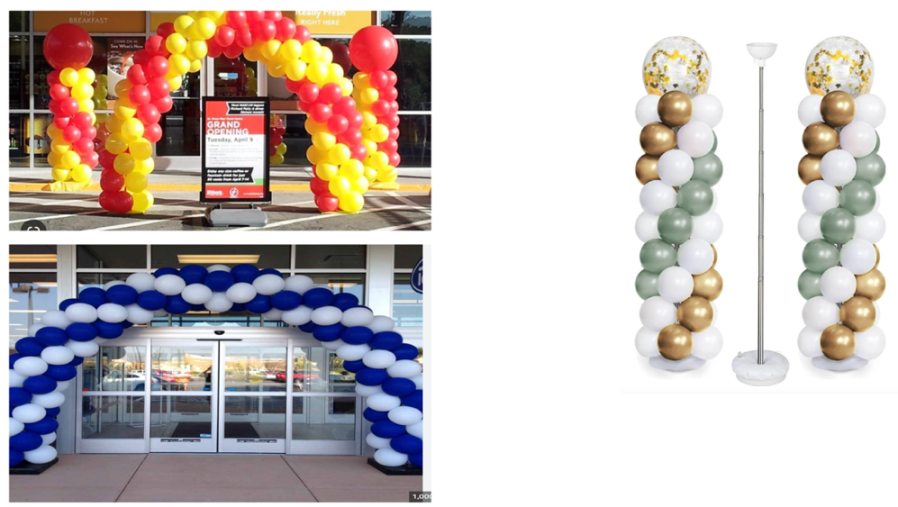
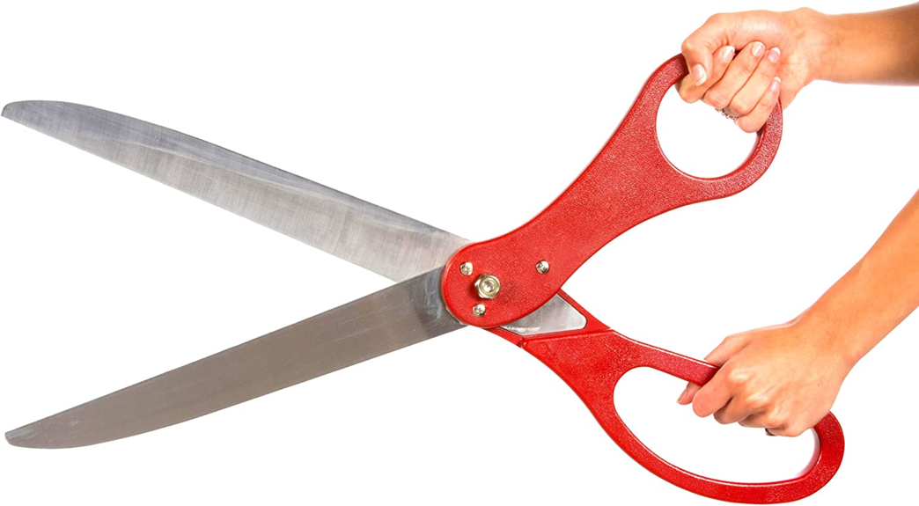
ADDITIONAL OPENING DAY MATERIALS (not provided by CDS)
CDS requests that Miami Grill also order additional opening day marketing materials such as balloons, a ribbon for a ribbon cutting ceremony, balloon arches or balloon columns, flags, or any additional banners etc. to draw more attention to the grand opening.
Sourcing these items and placing orders in time for the opening- These orders are the responsibility of the tenant and are not part of the print media packages sold through CDS. Below are some examples of items that have been used for grand openings in the past.
Examples of additional grand opening package materials-
NOTE: These types of materials can be purchased locally per city and state.

Slide 11
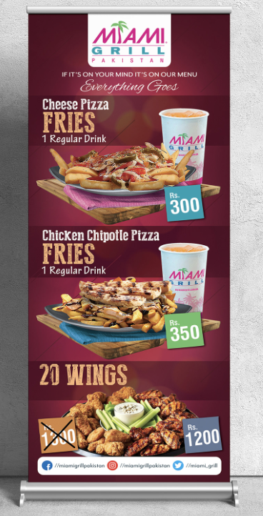
90/120 DAY REFRESH & ONGOING Marketing
Employee Discounts- 10,15 or 20 % off: Increases frequency of visits for Walmart Associates
Price Driven: Be sure all marketing materials include price points
Deals and Offer’s: Marketing materials should include Meals, Daily Specials (call to action)
Refresh Offer’s: Offers should be refreshed every 90 /120 days at min (offers become stale)
Guest & Operational Excellence- Cleanliness, Service, Operations & Everyday Value

